Slide 1
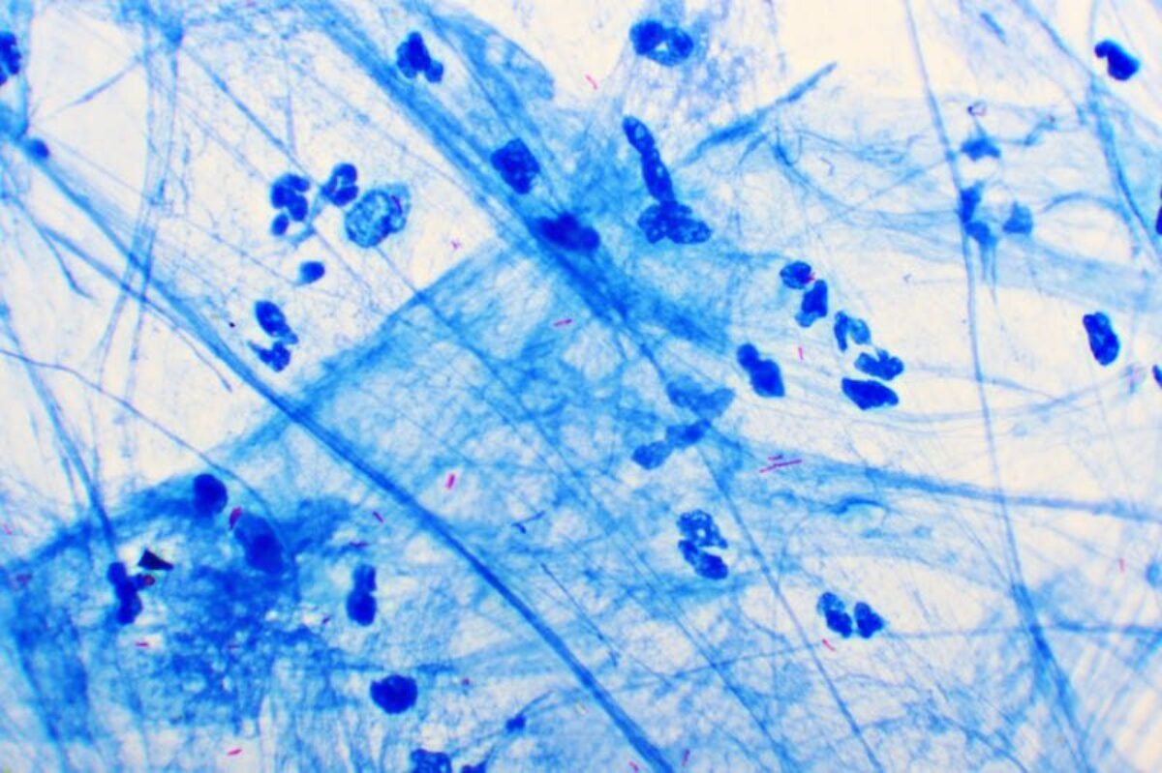
Mobile TB Care
Meriem Cherif, Dream Lopez, Meilin Yen,
Akshar Bhagat, Coco Sheng
Notes:
It’s useful for the physicians to know because we would be able to read the samples immediately by automating the sputum sample process, instead of asking the patient to return in a couple of days. This automated process could also bypass the chest x-ray.

Slide 2


Prediction problem
What is the decision?
The decision T that the algorithm improves is whether to initiate Active Tuberculosis (TB) treatment, by using smear image data to detect TB in a patient’s sputum
The decision maker is the physician, who will decide whether to treat the patient given sputum analysis and algorithm results
The final decision is made once the physician runs the algorithm and analyzes its conclusion
What are we predicting?
Based on the smear images, we can calculate probabilities that the patient has Active TB in their sputum
This prediction benefits the physician since the sputum analysis process is automated, allowing them to bypass chest x-rays and expand TB screening access by keeping services mobile
Smear Image
Start RX
TB
Health$
Notes:
It’s useful for the physicians to know because we would be able to read the samples immediately by automating the sputum sample process, instead of asking the patient to return in a couple of days. This automated process could also bypass the chest x-ray.

Slide 3
Prediction pitfalls
Do we have exactly the variable we want?
Yes, the measured Y is the visual identification of Active TB or other indications of TB on the smear images, which is a direct proxy for our true goal of identifying TB (Y*).
Is there a causal link between the decision and the variable?
No, there exists no causal link between the decision and the variable, rendering the algorithm a pure prediction problem
The algorithm utilizes the input variables X0 to directly predict the likelihood of a patient having TB, without modifying the underlying conditions that determine the presence or absence of TB in that patient.
X
T
Y*
Y
π

Slide 4
Summary
Our high-level goal is to help the physician detect active TB in a patient, in order to provide them life-saving treatment immediately
Our dataset includes key limitations:
Of ~75,000 images in the Nightingale Open Science dataset, only 5.2% of them show positive TB smears. This can lead to a high accuracy algorithm by predicting negative for every sample
The images come from smears taken in Asia; this regional uniformity could introduce confounding variables in the algorithm
These limitations have implications for how we would deploy our algorithm
In terms of how we adjust our algorithm, we might have to use other metrics of measuring algorithm performance such as precision and/or recall, as maximizing accuracy might not be the right course of action.
To enhance generalizability of the algorithm, we would also diversify the dataset by incorporating images from different geographical regions.

